Slide 1

Overview Spring Project
[BANG NGO]

Slide 2
Scenarios
As a Java Spring developer, how can I make project’s source code more readability, accessibility, efficiently ?
Leveraging the SOLID Modular Design.
Maximizing the use of Spring Boot Flow architecture.

Slide 3
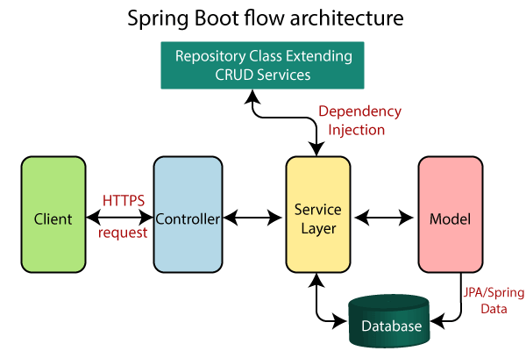
Spring Boot Flow Architecture
By the modular design, we have to write at least 4 separated packages as:
Controller.
Service.
Model.
Repository.

Slide 4

SOLID Modular Design
Encourages us to create more maintainable, understandable and flexible software.
As our applications grow in size, we can reduce their complexity.
Single Responsibility Principle (SRP).
Open/Closed Principle (OCP).
Liskov Substitution Principle (LSP).
Interface Segregation Principle (ISP).
Dependency Inversion Principle (DIP).

Slide 5
Overview Spring Project
Mainly, Spring Boot projects are used with Maven (Gradle, ..)
Here we will be using Spring Tool Suite 4 / Eclipse IDE.

Slide 6
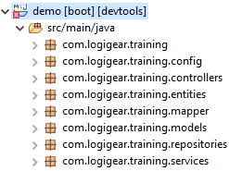
Overview Spring Project

Slide 7


Leverage Spring Boot External Resources

Slide 8
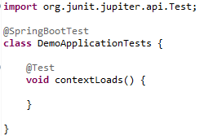
Leverage Spring Boot Test (TDD)

Slide 9

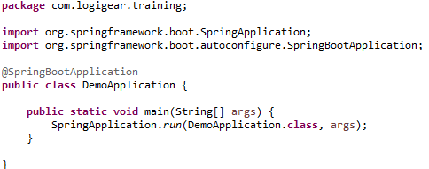
Spring Boot Entry Point

Slide 10

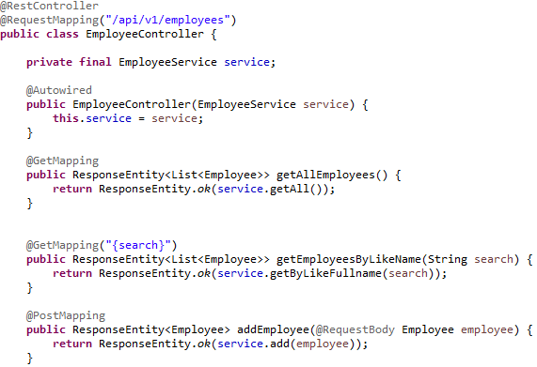
Employee Controller

Slide 11

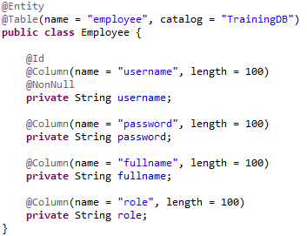
Employee Entity

Slide 12

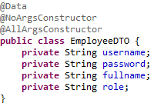
Employee DTO

Slide 13

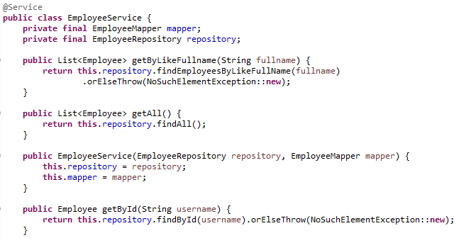
Employee Service

Slide 14


Employee Repository

Slide 15

Thank You!

